Slide 1


Data Science Capstone Project
Enrico

Slide 2
PREDICTING SUITABLE AREAS FOR INVESTMENTS
Problem
Background
Methodology
Explorative data analysis
Conclusions
Prediction
Business problem
Data
Predictive Models
Recommendations

Slide 3
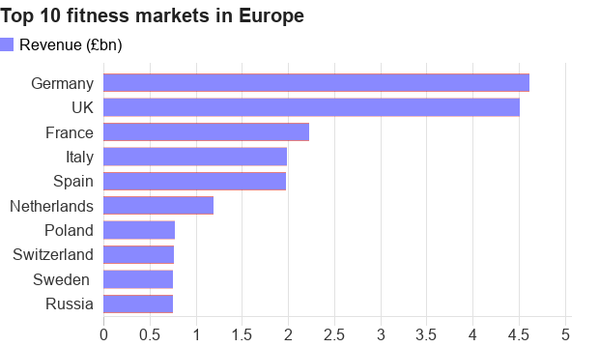
BACKGROUND
Fitness centers have a market value of 4.5 billion pounds and employs almost 50 thousand people across the UK. Business analysis on this market have estimate that this industry is expected to grow due to a general increase in health awareness. Therefore, it is reasonable that new investors in this sector and already established brands desire to know which area is the best for investments. I will try to explain to the stakeholders of a fitness company which are the best locations for growing their business.

Slide 4

THE PROBLEM
WHICH IS THE BEST LOCATION TO INVEST IN THE FITNESS INDUSTRY IN LONDON ?

Slide 5



THE DATA
DEMOGRAPHIC
ECONOMIC
COORDINATES
TOTAL POPULATION
POPULATION DENSITY
AVERAGE AGE
AVERAGE INCOME
VENUES LOCATION
BOROUGH BORDERS

Slide 6
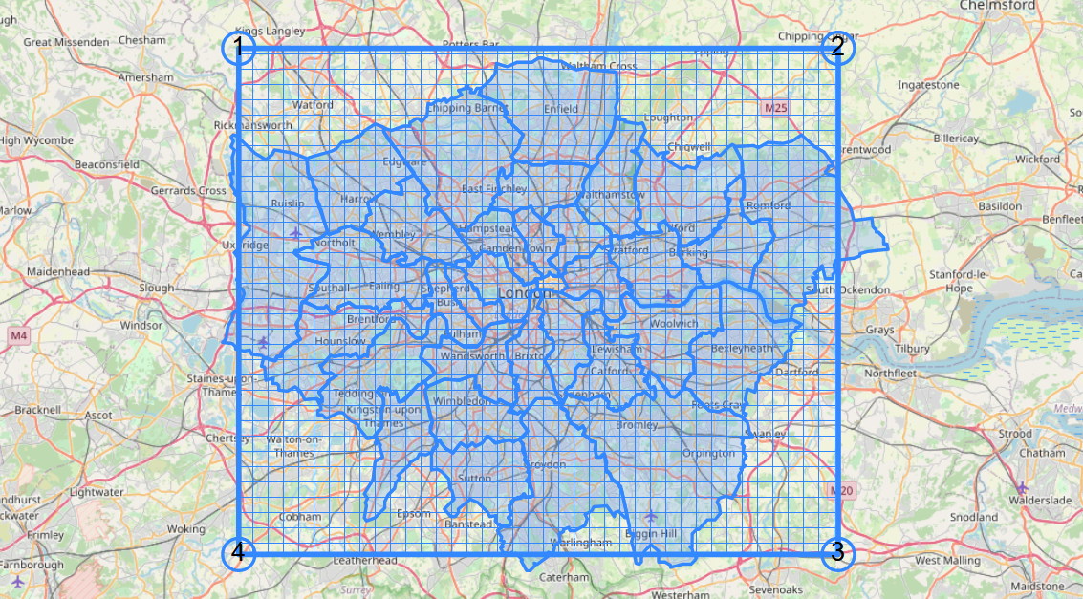
FOURTHSQUARE IMPLEMENTATION
DEFINE A RECTANGULAR AREA
SUBDIVIDE IT IN SMALLER SQUARES
CALL FOURTHSQUARE FOR VENUE EXPLORATION IN EVERY SQUARE
VENUE GEOCOORDINATES
VENUE UNIQUE IDs
VENUE NAMES

Slide 7
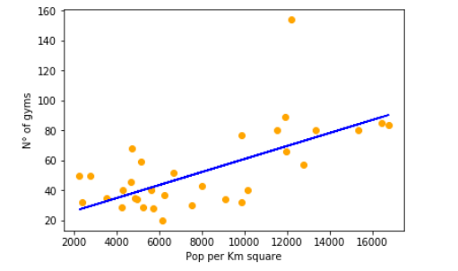
Relation between venue number and population density

Slide 8

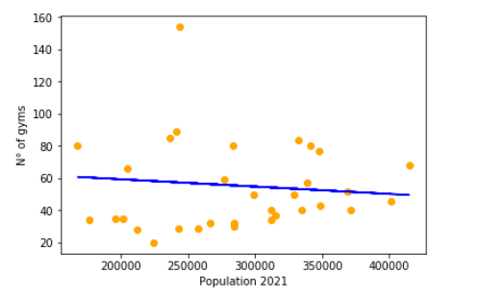
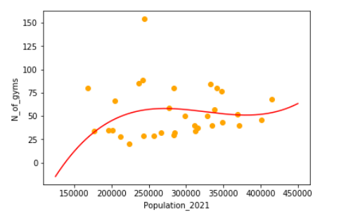
Relation between venue number and total population

Slide 9
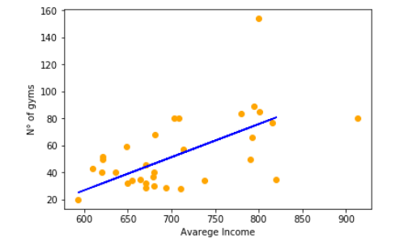
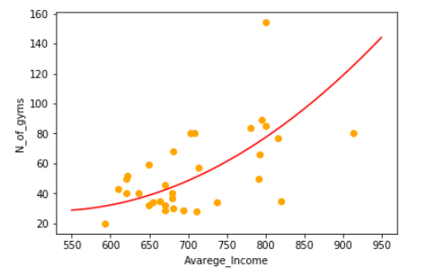
Relation between venue number and average income

Slide 10
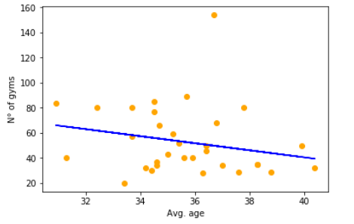
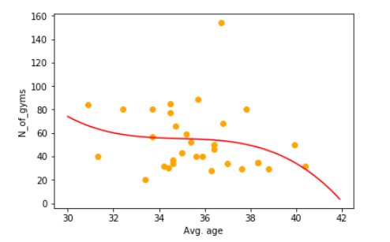
Relation between venue number and average age

Slide 11
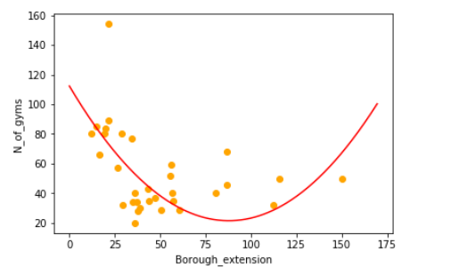
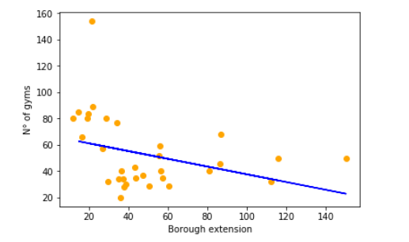
Relation between venue number and borough extension

Slide 12
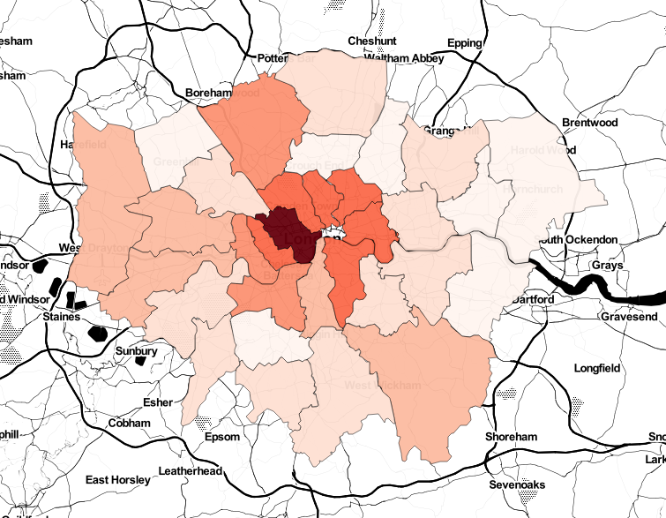
DENSITY OF FITNESS CENTERS

Slide 13
PREDICTIVE MODELS
MULTIPLE LINEAR REGRESSION
RANDOM FOREST REGRESSION
STATISTICAL METHOD ABLE TO PREDICT AN OUTCOME TAKING INTO ACCOUNT MULTIPLE VARIABLES
RELATION BETWEEN INDEPENDENT AND DEPENDENT VARIABLES MUST BE LINEAR
BOTH REGRESSION AND CLASSIFICATION
MAKES USE OF MANY DECISION TREES
TRAINS EVERY TREE WITH A DIFFERENT DATA SAMPLE
LINEAR DEPENDENCE NOT NEEDED

Slide 14
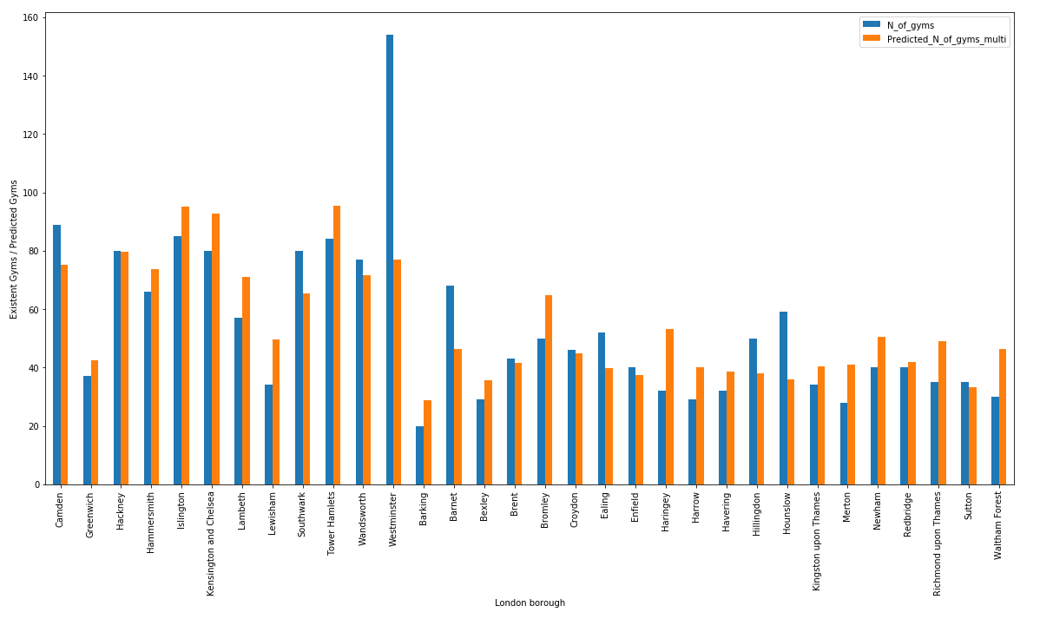
MULTIPLE LINEAR REGRESSION

Slide 15
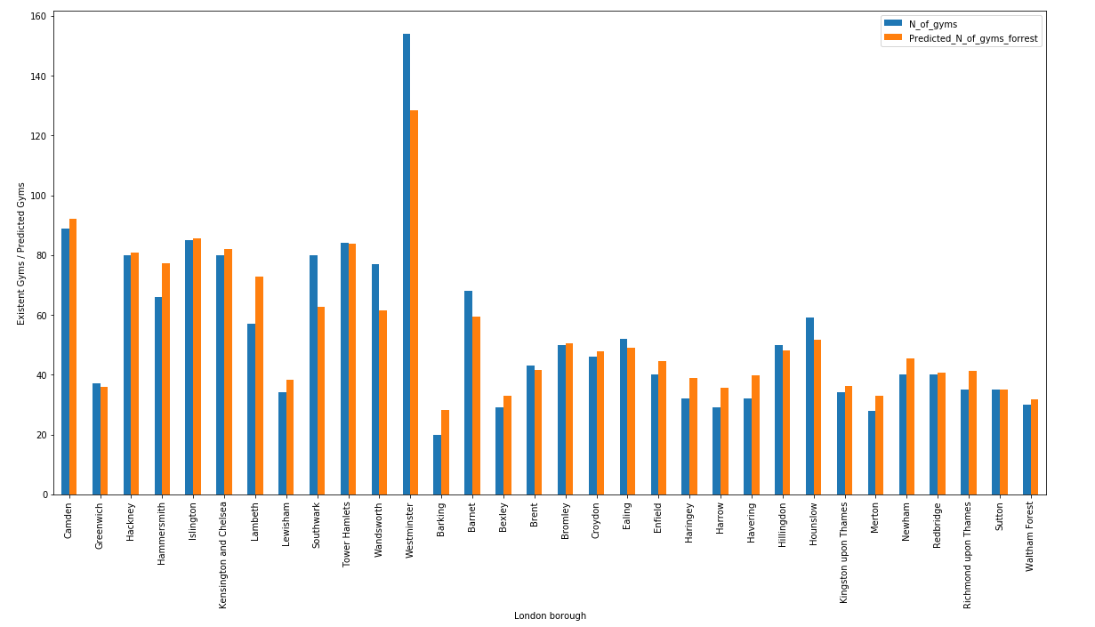
RANDOM FORESET REGRESSION

Slide 16
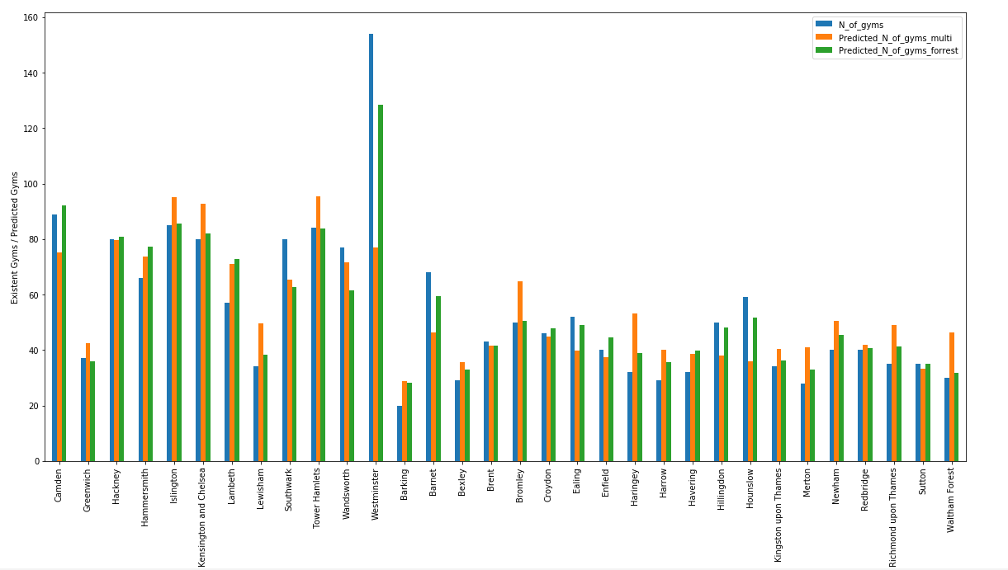
MLR & RANDOM FORESET REGRESSION

Slide 17
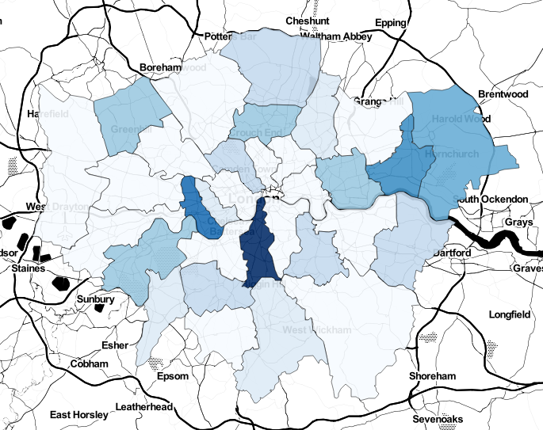
PREDICTION
THE BEST BROUGH FOR INVESTMENT IN THE FITNESS INDUSTRY ARE:
LAMBETH
HAMMERSMITH
BARKING

Slide 18

RECOMMENDATIONS
CONSIDER A BIGGER DATASET
TAKING INTO ACCOUNT DEMOGRAPHIC & ECONOMIC DATA VARIATION IN TIME
CONSIDER VENUE POPULARITY & RATING BASED ON LOCATION

